Slide 1

Intro to NServiceBus
9 – Other Features Worth Mentioning

Slide 2
Many other things in the box
Sagas
Multi-site distribution gateway | Helps Send messages across non-queue based networks
Sagas | Long running stateful business processes that call many NServiceBus endpoints over an determinant period of time.
DataBus
Message Pipeline
Clustering | Can participate in a windows failover cluster
Authentication
Azure support | Support for Azure infrastructure and multiple accounts for scale out
Load balancing | NServiceBus Distributor

Slide 3
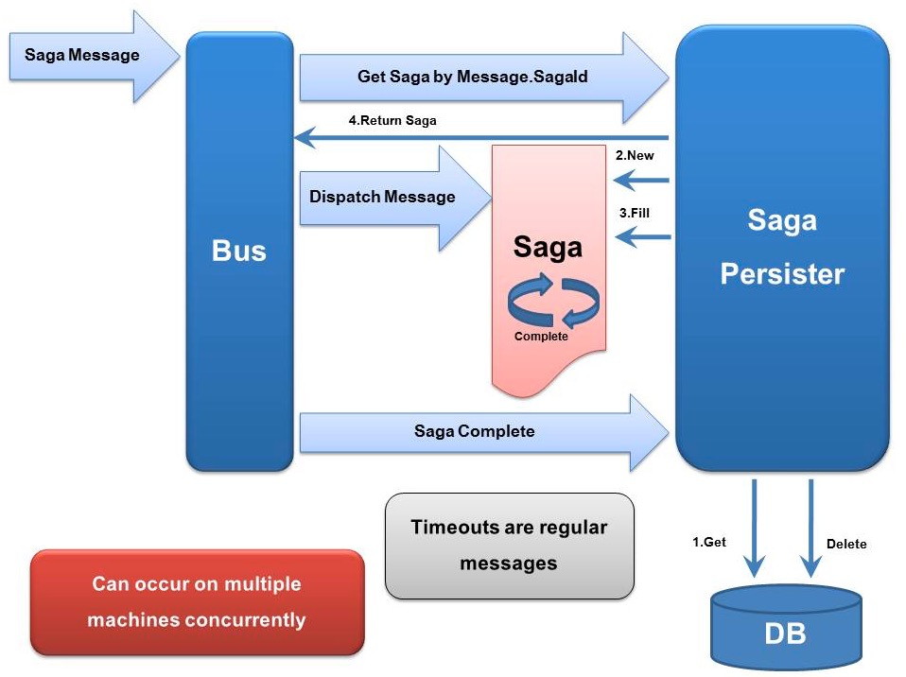
Sagas
Multiple, long running, stateful, transactional services

Slide 4
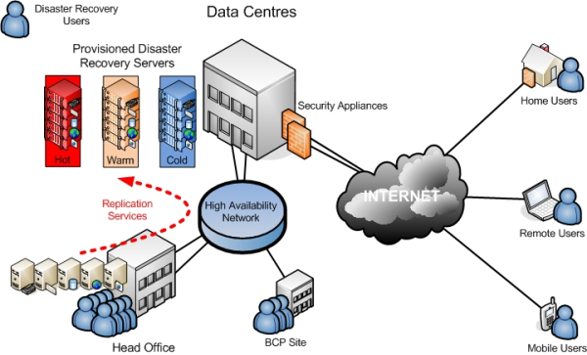
Multi-site distribution Gateway

Slide 5
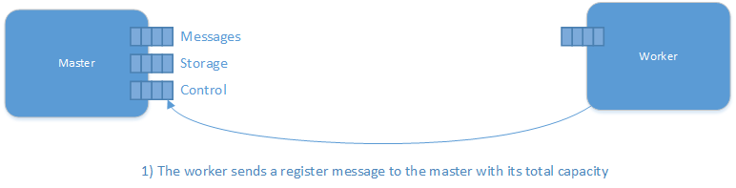
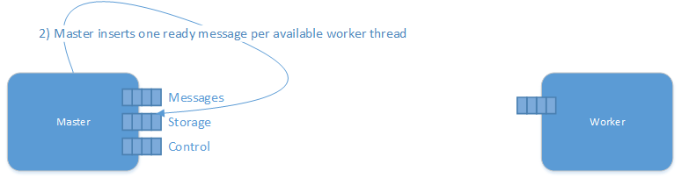
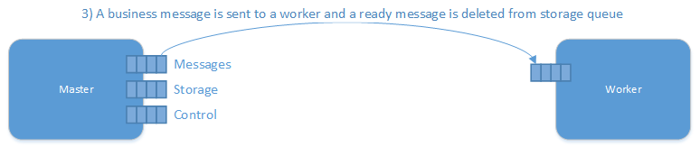
Distributor Process

Slide 6
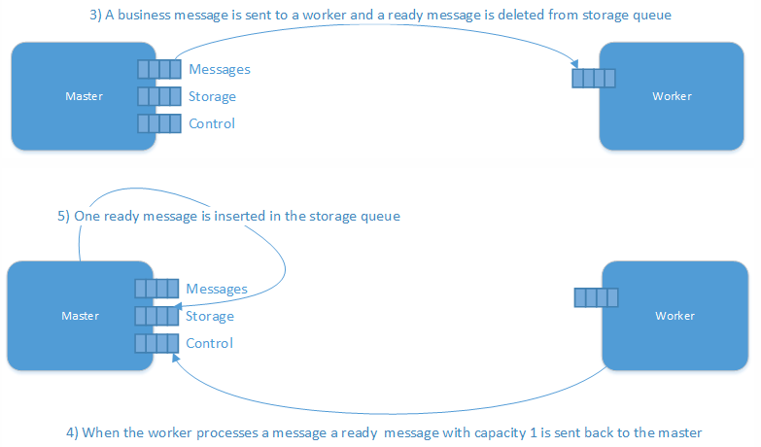
Distributor process 2

